Slide 1
Insert 1

Slide 2
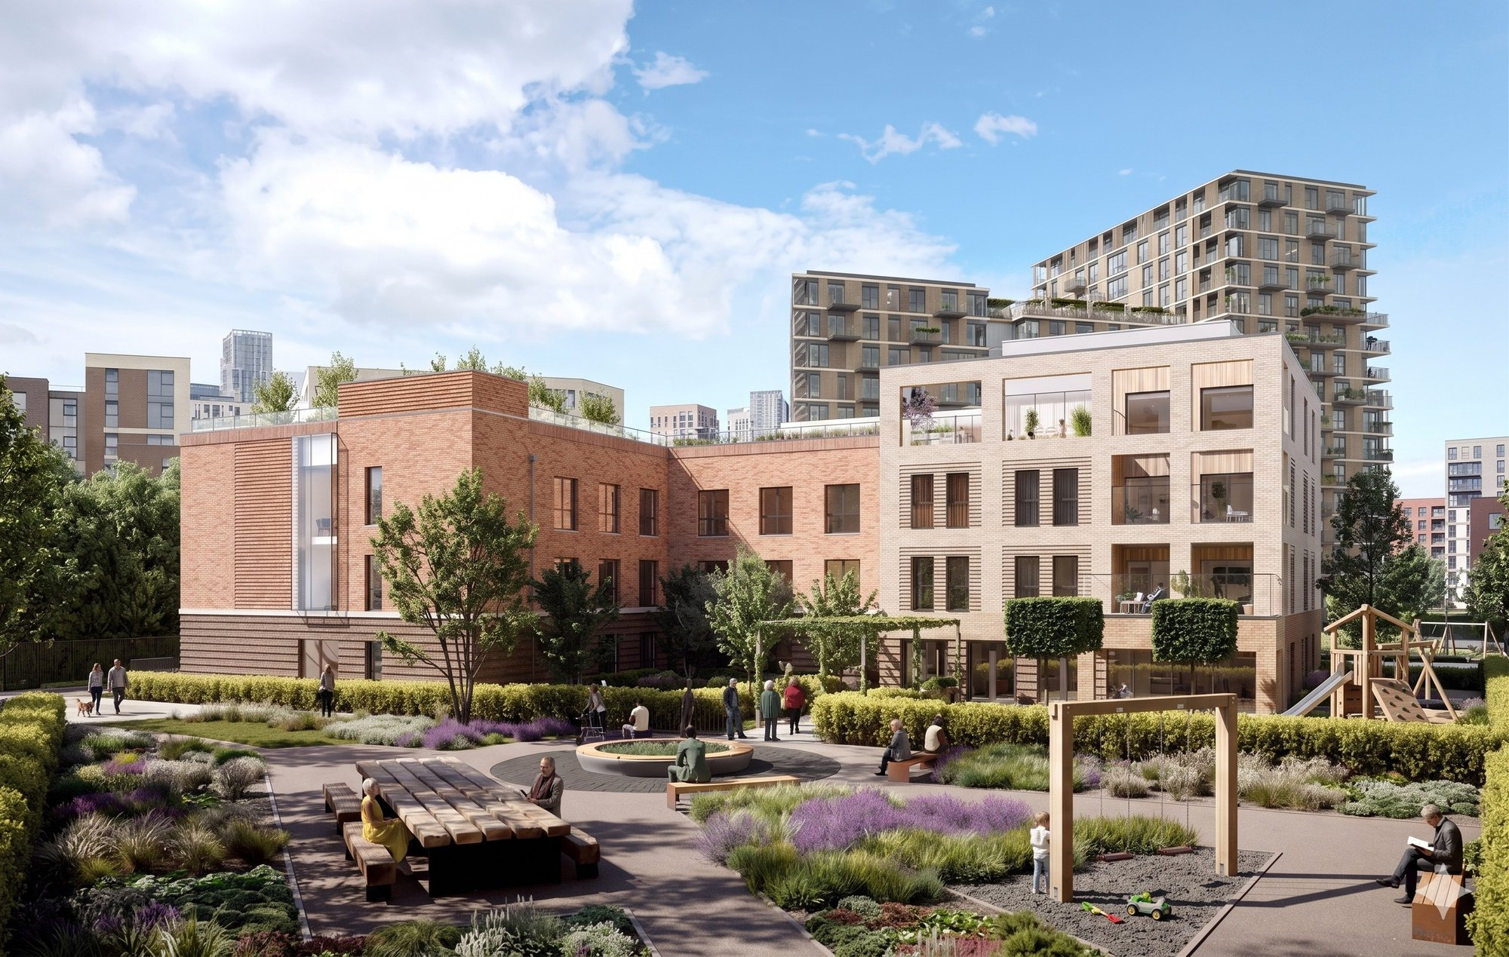

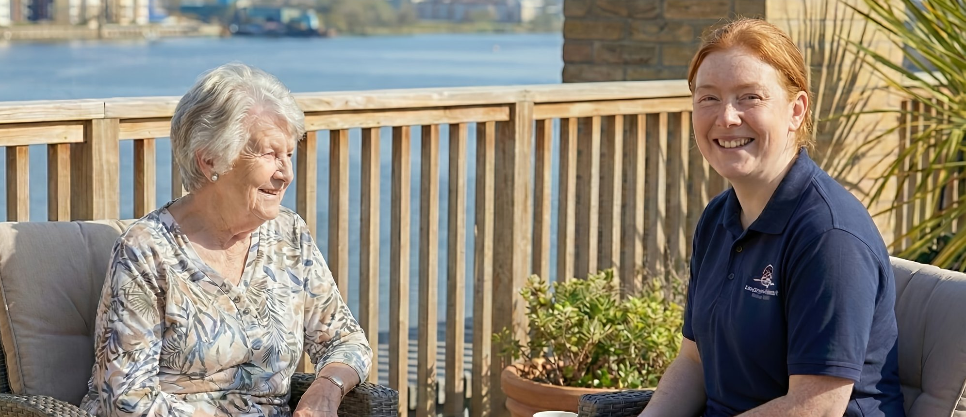
Welcome to Chatham Waters
WELCOME
ABOUT US
We believe later life should be lived with dignity, comfort, and meaningful connection. Every resident is treated with deep respect, with autonomy and individuality always honoured.
Care should never feel clinical or transactional; it should be personal and emotionally supportive from our ‘One Team’ approach.
Families deserve clarity and peace of mind, which is why Chatham Waters Care Home, its people and services have been designed with that full intention from the ground up.
A TRUE SANCTUARY
Our vision is to create a true sanctuary where people feel safe, valued, and at home. Every architectural choice, texture, and amenity contributes to an environment and experience that nurtures mind, body, and soul.
At Chatham Waters, our vision is shaped by a commitment to a truly compassionate service, partnerships, and innovation that supports our residents’ wellbeing.
We hire for heart, not just skill. Our ‘One Team’ approach is underpinned with training in emotional intelligence and compassionate care, to foster a culture of mutual respect, shared purpose, and safety.
WHAT WE OFFER
We offer residential, dementia, and respite care tailored to each individual. Every room includes a full ensuite shower room, and our inclusive pricing ensures clarity and peace of mind.
Situated beside the peaceful Chatham Waters promenade, our home offers easy access for families and visitors, with nearby amenities and transport links.
Our home includes a rooftop garden, entertainment suite, salon, gym, sanctuary space, private dining, library spaces, and café/bistro - all designed to support sensory comfort, activity and social connection.
OPENING SUMMER 2026
01634 623548 · info@chathamwaterscarehome.co.uk
REGISTER INTEREST
CHATHAMWATERSCAREHOME.CO.UK

Slide 3
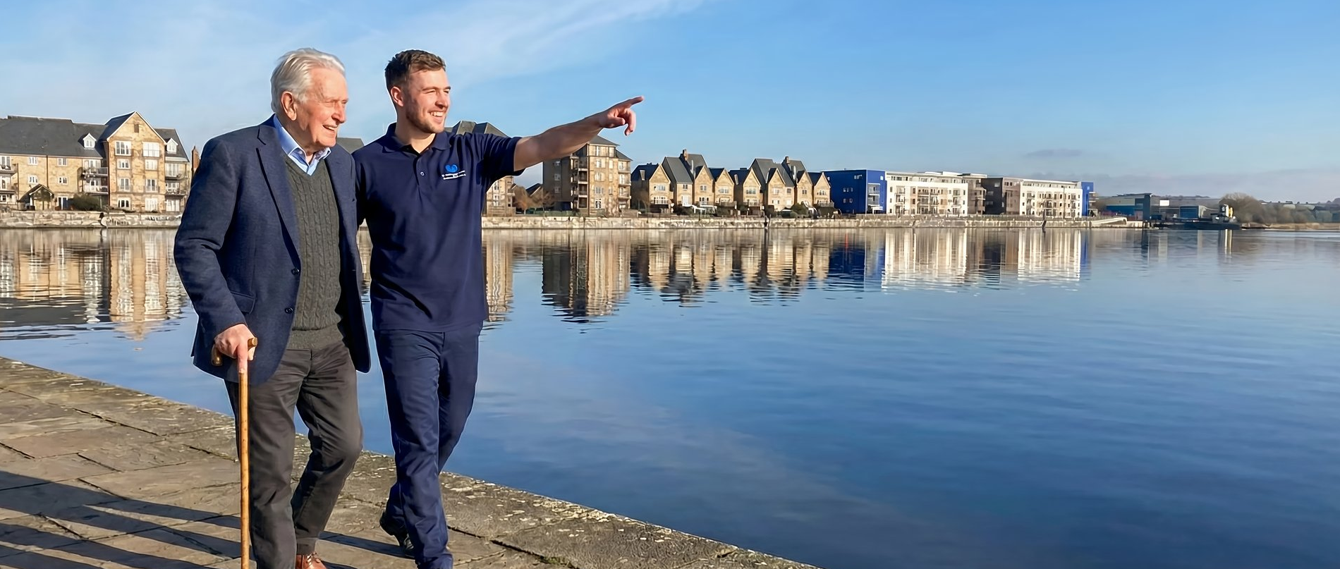
Our Location
Beside the Water. Close to Everything.
WHERE WE ARE
HOW TO FIND US
WHAT’S NEARBY
BESIDE THE WATERFRONT
GETTING HERE
LOCAL AMENITIES
Chatham Waters Care Home is located in Kent beside the tranquil Chatham Docks waterfront, offering a peaceful, scenic environment that supports wellbeing and calm.
The surrounding promenade, landscaped gardens, and open skies create a sense of space and sanctuary — ideal for residents and visitors alike.
The location offers the best of both worlds — the restorative calm of the water with easy access to local amenities and transport links.
By Car
Waterfront promenade and walking routes on the doorstep
Town centre shopping, dining, and culture close by
ASDA, a pub, park and children’s play area adjacent
Historic Dockyard and Rochester high street nearby
Medway Maritime Hospital and GP services a short drive
Direct bus and rail links via Chatham and Gillingham
Easily accessible from the M2 and A2, with clear road signage directing you to Chatham Waters. On-site parking is available for visitors, with designated spaces close to the main entrance.
By Public Transport
Chatham Railway Station is approximately 1.5 miles away, with regular services to London, Maidstone, and surrounding areas. Local bus routes serve the Chatham Waters development, with stops within walking distance.
Chatham Waters Care Home
Gillingham Gate Road
Gillingham, Kent
ME4 4FT
Tel: 01634 623548
Info@chathamwaterscarehome.co.uk
www.chathamwaterscarehome.co.uk
FIND US
By Foot
Search “Chatham Waters Care Home” on Google Maps for turn-by-turn directions, or use postcode ME4 4FT. On-site visitor parking available.
The waterfront promenade provides a pleasant walking route from Chatham town centre. Pathways are level and well-lit, suitable for all mobility levels.
Everything you need, right on your doorstep.
OPENING SUMMER 2026
01634 623548 · info@chathamwaterscarehome.co.uk
REGISTER INTEREST
CHATHAMWATERSCAREHOME.CO.UK

Slide 4
Insert 2

Slide 5
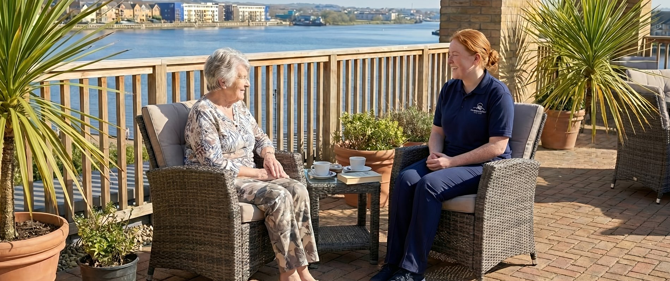



[HERO: Values / lifestyle image — swap in PowerPoint]
Our Vision
Our Vision
Built on Values. Delivered with Heart.
WHY WE EXIST
At Chatham Waters Care Home, care is grounded in our core values, creating a home where every resident feels safe, respected, and connected. Removing complexity, honouring individuality, and delivering emotionally intelligent, high quality and compassionate care.
OUR CORE VALUES
Three commitments that shape everything we do:
COMPASSION
PARTNERSHIPS
INNOVATION IN WELLBEING
We go beyond expectations with care that is truly compassionate and shaped by each resident’s needs. Every interaction builds trust with a team that anticipates needs, listens deeply, and responds with warmth and professionalism.
We work closely with families, professionals, and residents to co-create care pathways. Shared decisions and transparent communication ensure you always know what’s happening and feel informed, involved, and empowered.
From sensory design to emotionally attuned staffing, we use innovation to enhance our residents’ quality of life and wellbeing. We learn, adapt, and improve, guided by best practice, lived experience, and a commitment to doing better.
OPENING SUMMER 2026
01634 623548 · info@chathamwaterscarehome.co.uk
REGISTER INTEREST
CHATHAMWATERSCAREHOME.CO.UK

Slide 6
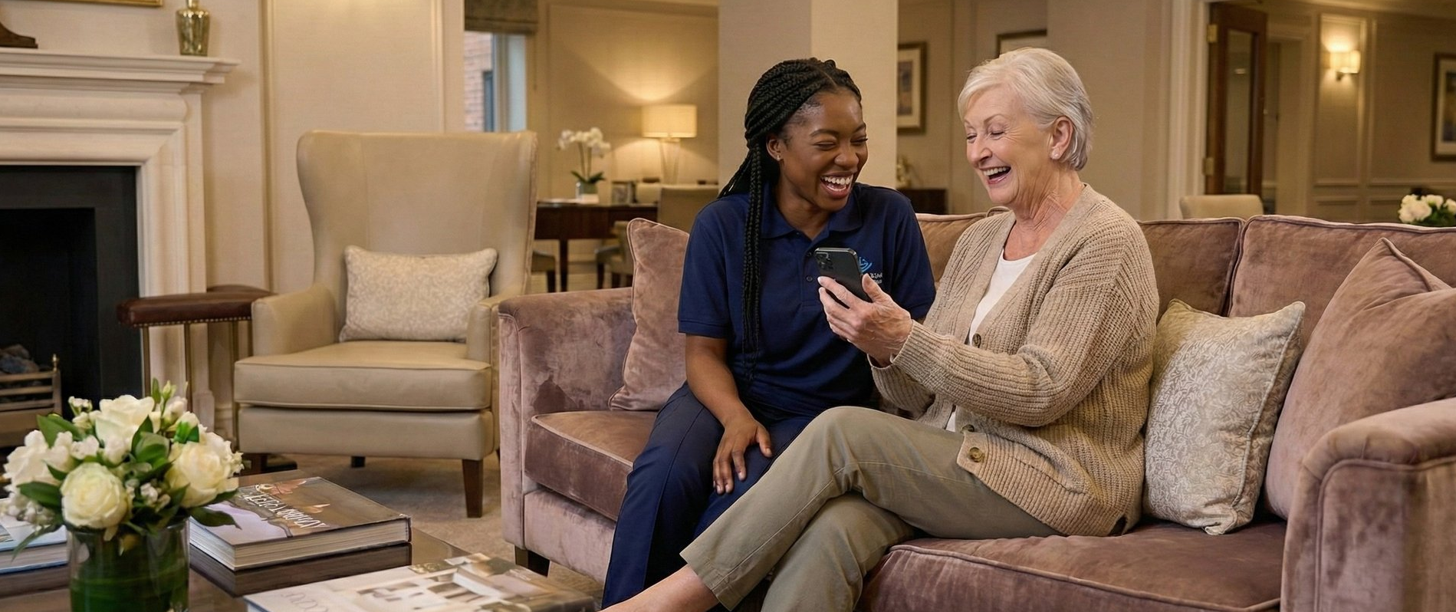
[HERO: Staff / lifestyle image — swap in PowerPoint]
Our Values in Action
HOW WE HIRE AND TRAIN
A HOME THAT REFLECTS OUR VALUES
WHAT THIS MEANS FOR YOU
The People Behind the Care
Designed with Purpose
When you choose Chatham Waters, you’re choosing:
We recruit for both compassion and competence, often involving residents in the hiring process. We look for people with heart, emotional intelligence, and a genuine desire to make a difference.
Our ‘One Team’ approach benefits from:
Every detail of our home reflects our commitment to comfort, clarity, and emotional wellbeing, designed to feel familiar, uplifting, and safe. We want residents to feel at home from the moment they arrive.
A beautiful haven shaped with intention:
Clarity: Transparent and inclusive pricing, open communication, and no hidden surprises
Dignity: Care that respects autonomy, preserves identity, and honours choice
Connection: A community where relationships matter and isolation is actively prevented
Quality: Clinically excellent care delivered with emotional intelligence
Peace of Mind: Knowing your loved one is safe, valued, and genuinely cared for
Textures, colours, lighting, and layout chosen to reduce anxiety and support orientation
Spaces that invite connection and create a sense of belonging
A rooftop garden to feel the breeze and watch the water
A café/bistro where families can share meals and moments
A sanctuary space to offer calm reflection and therapy
Clear recognition that every role — from care to housekeeping — equally shapes and shares in our residents’ experience
Training in emotional intelligence, dementia awareness, and inclusive communication
A culture of psychological safety, mutual respect, and ongoing development
Choosing care is one of the most personal and difficult decisions you’ll ever make. Our vision exists to make that process easier, offering a home that truly feels like home.
Every space is shaped to help people feel calm, connected, and at home.
We invest in our people because confident, supported and integrated teams deliver the very best care.
OPENING SUMMER 2026
01634 623548 · info@chathamwaterscarehome.co.uk
REGISTER INTEREST
CHATHAMWATERSCAREHOME.CO.UK

Slide 7
Insert 3

Slide 8
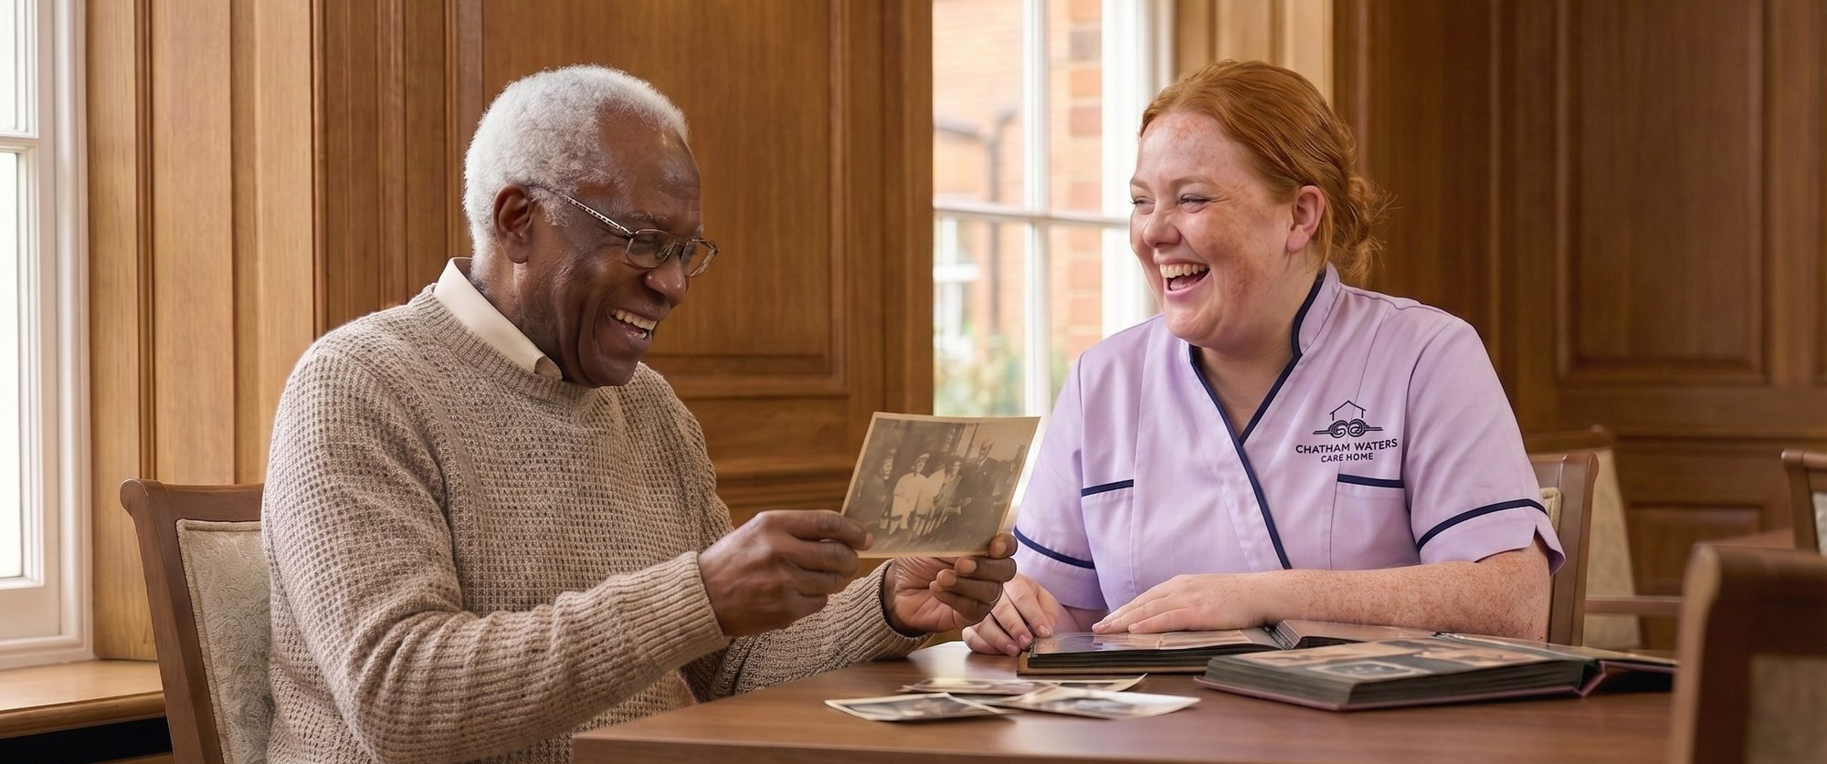
[HERO: Care lifestyle image — swap in PowerPoint]
Our Services
Tailored Support. Inclusive Living.
At Chatham Waters Care Home, we provide residential, dementia, and respite care shaped by clarity, dignity, and compassion. Our care and support services are flexible, responsive, and guided by emotional sensitivity.
Every care and support plan reflects the resident, their preferences, and their changing needs.
RESIDENTIAL CARE
DEMENTIA CARE
RESPITE CARE
Our residential care supports people who need help with daily living while maintaining independence and routine. Every resident has a private ensuite shower room, full access to all amenities, and a personalised care plan.
We provide luxury residential dementia care designed to reduce anxiety and support memory. Our team is fully trained in dementia awareness and inclusive communication, with sensory cues, familiar layouts, and calming spaces.
Our respite care offers short-term support for people recovering from illness or for individuals and their families needing temporary relief. Residents receive the same amenities, care planning, and emotional support as those staying long-term.
Comfort, connection, and continuity
Support that follows your routines and preferences
Care that adapts to your life at your pace
Personal care and medication support
Help with mobility and meals
Skilled, sensitive responses that keep you in control of your choices
Preserving identity and fostering moments of joy
Communication adapted to each person’s needs
Activities that are meaningful and always voluntary
Environments that support orientation without overwhelming
Families as partners in care
Emotional support for relatives throughout the journey
A safe and welcoming place to rest and recover
A private room and full access to all facilities
Care tailored to your needs for a few days or a few weeks
Essential breathing space for family carers
Confidence that your loved one is well supported
Practical help with medication, meals, activities, and personal care
OPENING SUMMER 2026
01634 623548 · info@chathamwaterscarehome.co.uk
REGISTER INTEREST
CHATHAMWATERSCAREHOME.CO.UK

Slide 9
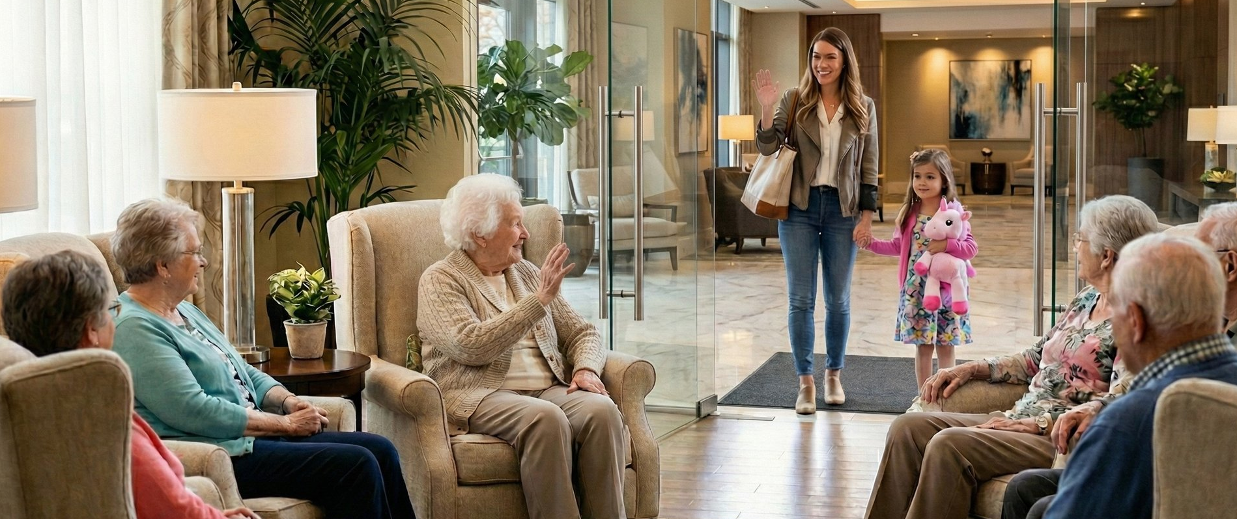

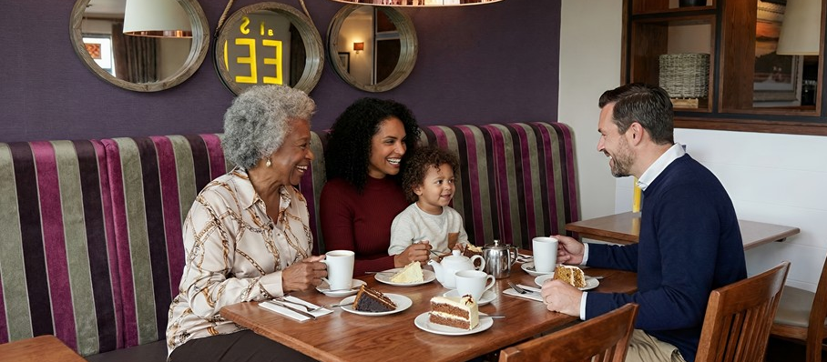
[HERO: Family / visiting image — swap in PowerPoint]
Partnership with Families
PARTNERSHIP WITH FAMILIES
YOUR QUESTIONS ANSWERED
We recognise that families are essential to delivering the best care. You know your loved one better than anyone, and we welcome your involvement, insights, and questions.
What happens when you contact us:
Initial conversation — we listen to your needs and answer your questions
Arrange a visit — see the home, meet the team, get a feel for the environment
Assessment — we discuss care needs, preferences, and how we can help
Care plan — we create a personalised plan together
Move-in support — we make the transition as smooth and reassuring as possible
Ongoing review — care is never static; we adapt as needs change
How we support families:
Regular updates on wellbeing and care
Open invitation to care planning meetings
Flexible visiting hours with private spaces available
Video calls for families who live further away
Family dining welcome — bring relatives to share meals at no extra charge
24/7 contact access for urgent concerns
Support with difficult decisions and transitions
Honest, compassionate communication at every stage
You’re never left wondering. You’re never shut out. We’re here to work alongside you, offering support for your loved one and for you.
There’s no pressure. No rush. We move at your pace and respect your process.
OPENING SUMMER 2026
01634 623548 · info@chathamwaterscarehome.co.uk
REGISTER INTEREST
CHATHAMWATERSCAREHOME.CO.UK

Slide 10
Insert 4

Slide 11
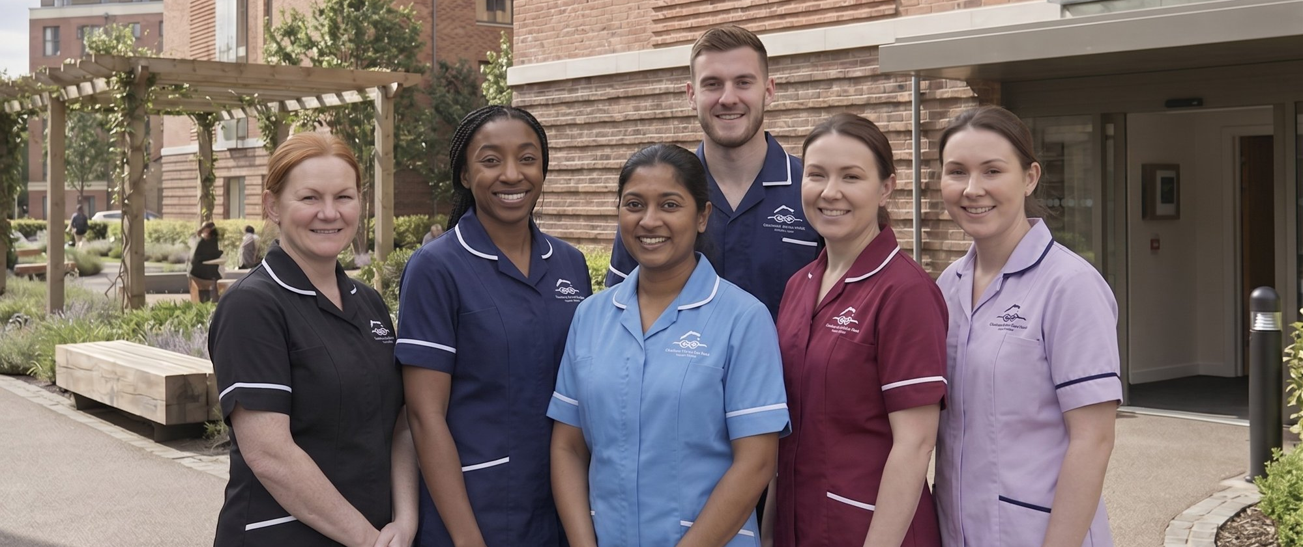
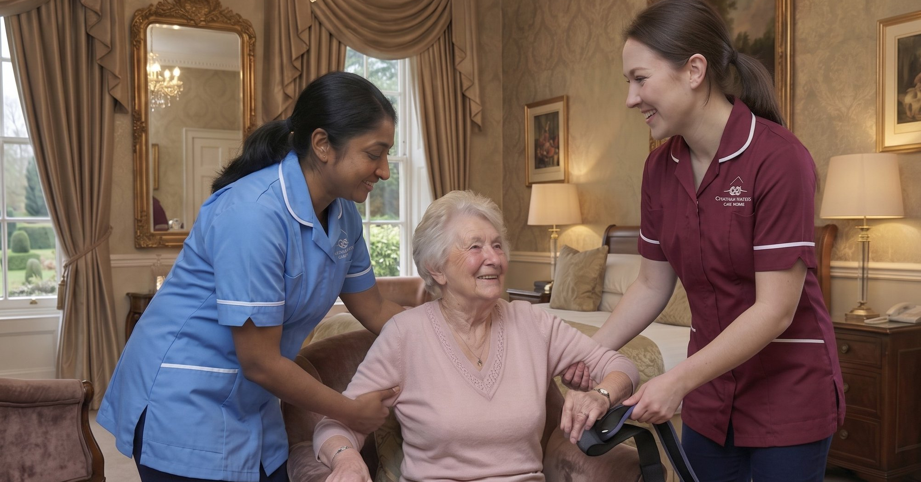
[HERO: Team / staff image — swap in PowerPoint]
[HERO: Family / visiting image — swap in PowerPoint]
Our Team
Compassion-Led. Resident-Informed.
THE PEOPLE BEHIND THE CARE
HOW WE WORK TOGETHER
We work collaboratively as ‘One Team’ across disciplines, with regular meetings, shared training, care planning, and open communication. Staff build strong relationships with residents and families, so everyone feels seen, heard, and valued.
At Chatham Waters Care Home, great care begins with great people. Our ‘One Team’ is chosen for compassion, skill, and the ability to connect with dignity.
Residents help shape recruitment, reinforcing transparency and shared purpose.
Your ‘One Team’ will get to know your routines, preferences, and personality, noticing changes and responding with care. That’s what makes this home feel like home.
Our culture
Mutual respect, shared purpose, and psychological safety
Space to raise concerns, share ideas, and celebrate success
Supportive and collaborative teams that create better care for residents
HOW WE HIRE AND TRAIN
We recruit for compassion and shared values, with residents often joining interviews to help choose team members who truly understand what it means to care.
Leadership and teamwork
Visible, accessible leadership
Decisions shaped by input from the whole team
Every role recognised, from the care team to housekeeping
Training in our ‘One Team’ approach, dementia awareness, emotional intelligence, inclusive communication, and best care and hospitality practice
A culture of continuous learning, reflective supervision, and psychological safety
Regular updates to keep skills current and knowledge sharp
Support for further qualifications and career progression
Investment in staff so confident, well-supported teams can deliver the best care and support
OPENING SUMMER 2026
01634 623548 · info@chathamwaterscarehome.co.uk
REGISTER INTEREST
CHATHAMWATERSCAREHOME.CO.UK

Slide 12
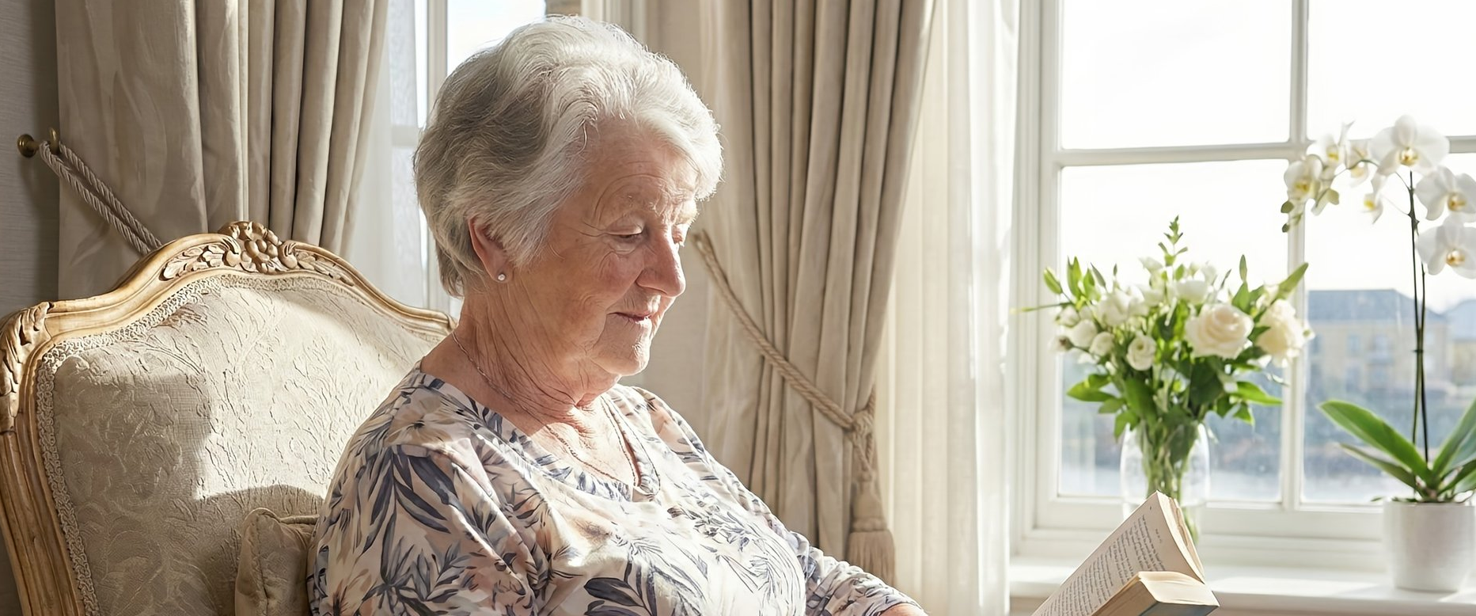
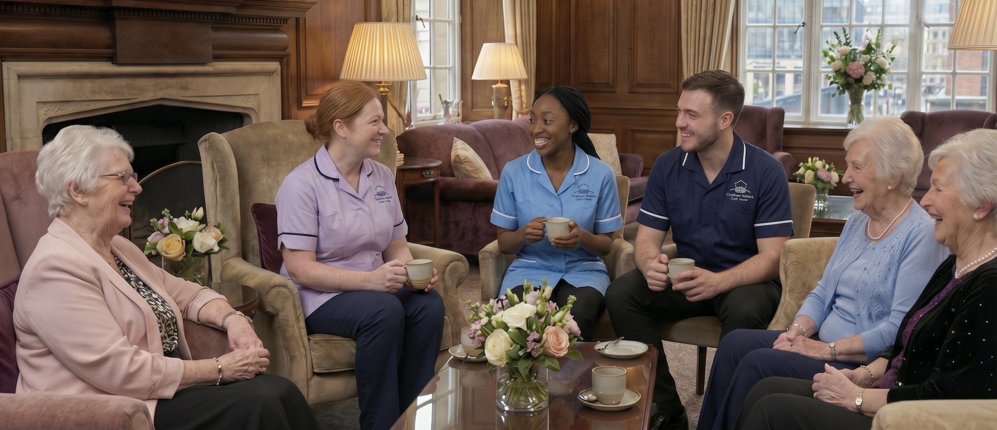
[HERO: Care / welcome image — swap in PowerPoint]
[HERO: Family / visiting image — swap in PowerPoint]
Your Journey
WHO DOES WHAT
LEADERSHIP THAT LISTENS
STEP BY STEP
Care Assistants provide hands-on support with daily living: personal care, mobility, mealtimes, and companionship. They’re often the team members residents see most frequently.
Our leadership team brings vast experience across health and social care, hospitality, and care service innovation. Together they foster a culture of trust, accountability, and excellence, with every decision guided by resident wellbeing.
First Contact — you reach out, and we take time to understand you
Your Visit — you tour the home, meet the team, and ask us anything
Getting to Know You — together we shape care around your needs and wishes
Your Care Plan — a personalised plan, agreed with you and your family
Moving In — you arrive at your own pace, welcomed and supported
Living Well — you settle in, with care that adapts as life changes
Hospitality and Wellbeing Teams manage the kitchen, café/bistro, activities programmes, and social events. They create the warmth and connection that makes this feel like home.
How leadership shows up:
Hands-on, visible, and present in daily life
Approachable and responsive in communal spaces
Actively supporting staff and engaging with residents
Housekeeping and Maintenance ensure the environment remains clean, safe, and comfortable. Their attention to detail supports dignity and wellbeing.
Our leadership principles:
Compassion modelled in every interaction
Listening, learning, and adapting when needed
Every role connects. Every person contributes to the quality of life residents experience here in our ‘One Team’ approach.
WE ARE HERE TO HELP
Choosing care is a deeply personal decision. Whether you’re ready to register interest or simply want to explore your options, our team is here to guide you with clarity, warmth, and respect.
OPENING SUMMER 2026
01634 623548 · info@chathamwaterscarehome.co.uk
REGISTER INTEREST
CHATHAMWATERSCAREHOME.CO.UK

Slide 13
Insert 5

Slide 14
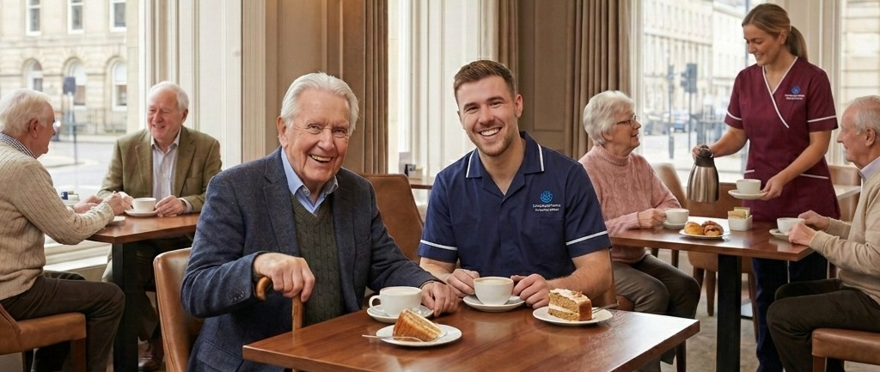

[HERO IMAGE 9 — Lifestyle / dining — swap in PowerPoint]
[HERO: Family / visiting image — swap in PowerPoint]
Your Lifestyle
Living Well, Every Day.
At Chatham Waters Care Home, lifestyle is an essential part of the care experience. We create opportunities for enjoyment, connection, and personal fulfilment — tailored to each resident’s interests and abilities.
DINING AND CATERING
ACTIVITIES AND ENTERTAINMENT
Our dementia-friendly café/bistro sits at the heart of daily life. Mealtimes are social and unhurried, shaped by resident preferences and fresh, locally sourced ingredients. Between meals, the café/bistro stays open for tea, coffee, snacks, and conversation.
Our entertainment suite offers shared activity opportunities, memory stimulation, and community events.
A welcoming place to dine with friends, family, or staff
Fresh, resident-informed menus and all-day access
Family and friends welcome to join meals at no extra charge
Classic films, new releases, and resident favourites
Interactive games, sports events, and music shows
Library spaces for reading or quiet conversation
Community events, talks, and visiting performers
SAMPLE MENU
BREAKFAST
LUNCH & DINNER
Activities are always voluntary and shaped by residents’ interests.
Freshly scrambled eggs with smoked salmon on toasted sourdough
Porridge with honey, cinnamon, and fresh berries
Full English with locally sourced sausage and free-range eggs
Toast, preserves, pastries, fresh fruit, and cereals available daily
Roasted butternut squash soup with crusty bread
Chicken and leek pie with seasonal vegetables
Poached salmon with new potatoes and watercress
Mushroom risotto with parmesan and fresh herbs
HAIRDRESSING AND GROOMING
Our on-site salon provides hairdressing and grooming in a calm, private setting that supports routine and identity. Regular appointments are included in your weekly fee at no extra charge.
Fresh, seasonal, and shaped by resident preferences
OPENING SUMMER 2026
01634 623548 · info@chathamwaterscarehome.co.uk
REGISTER INTEREST
CHATHAMWATERSCAREHOME.CO.UK

Slide 15
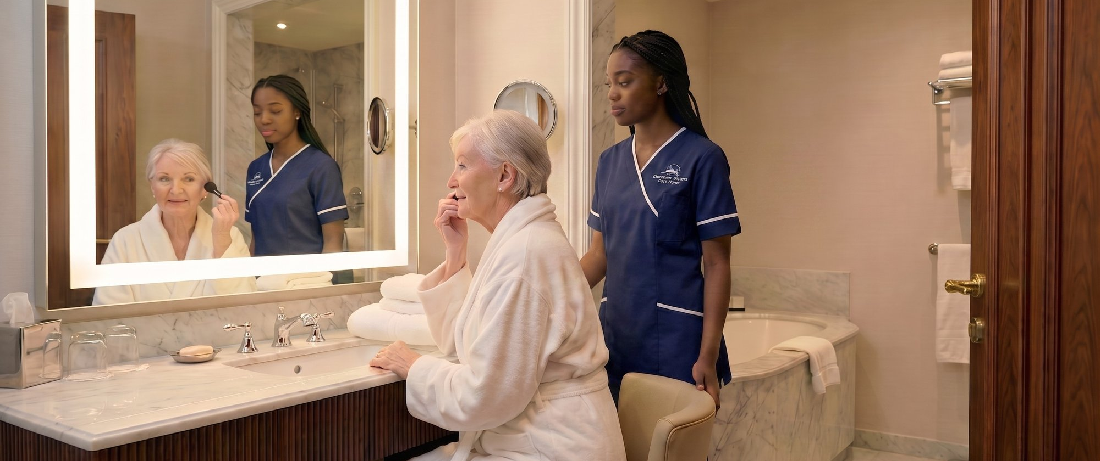
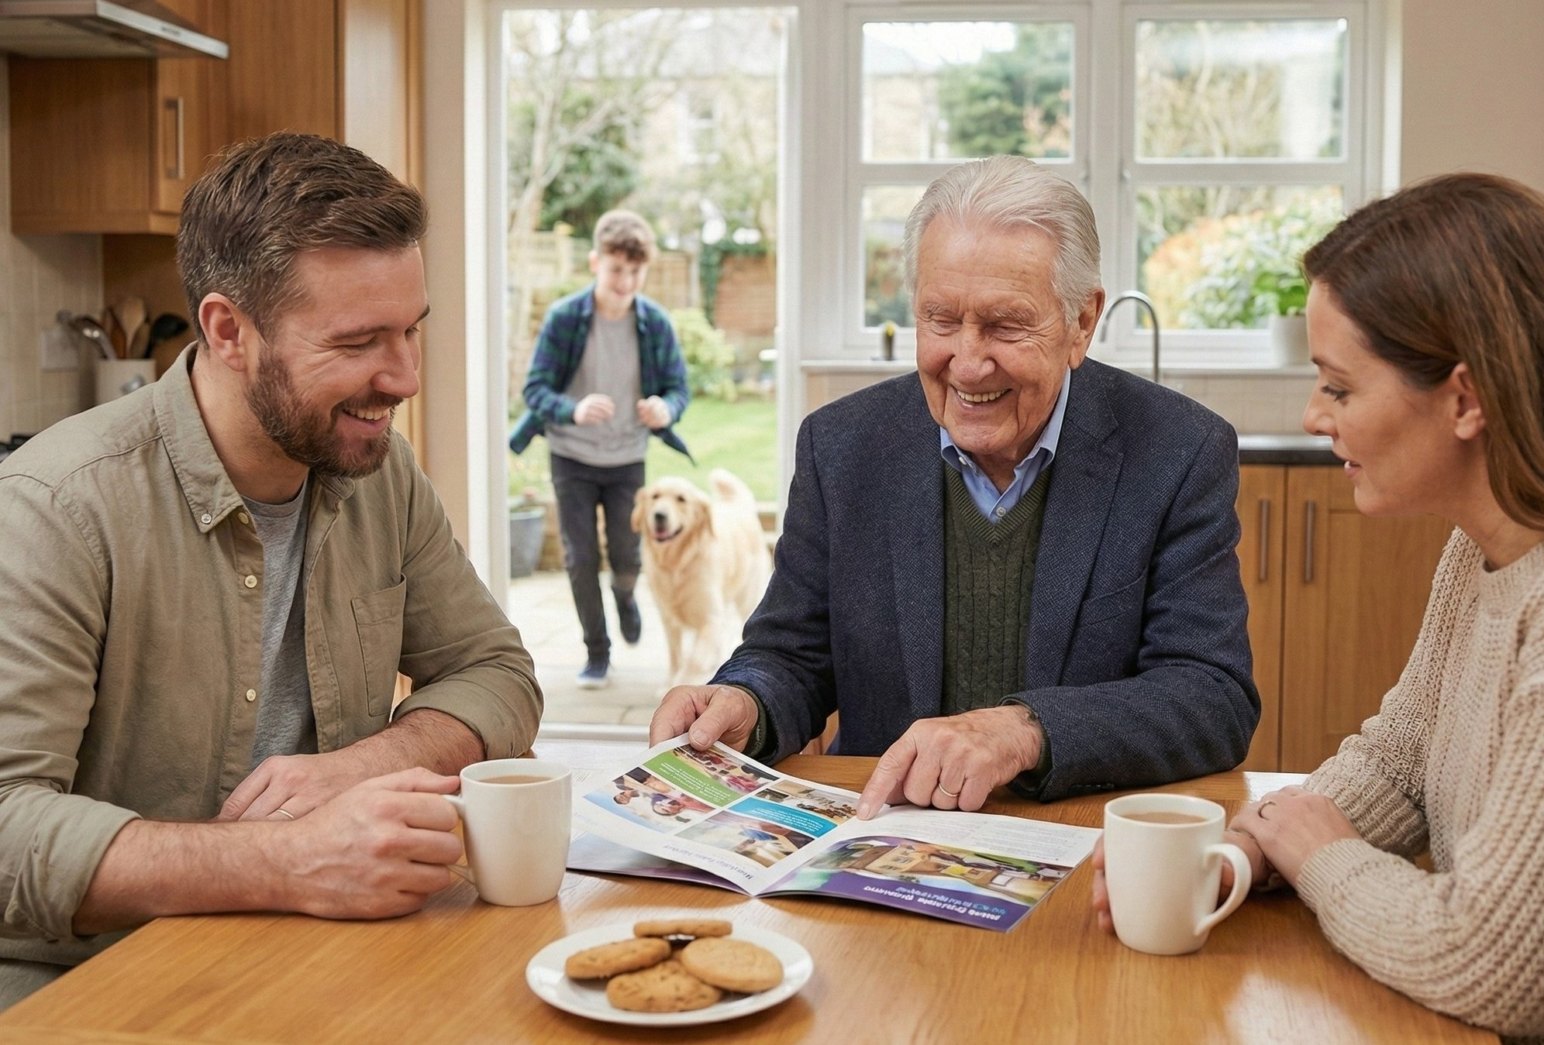
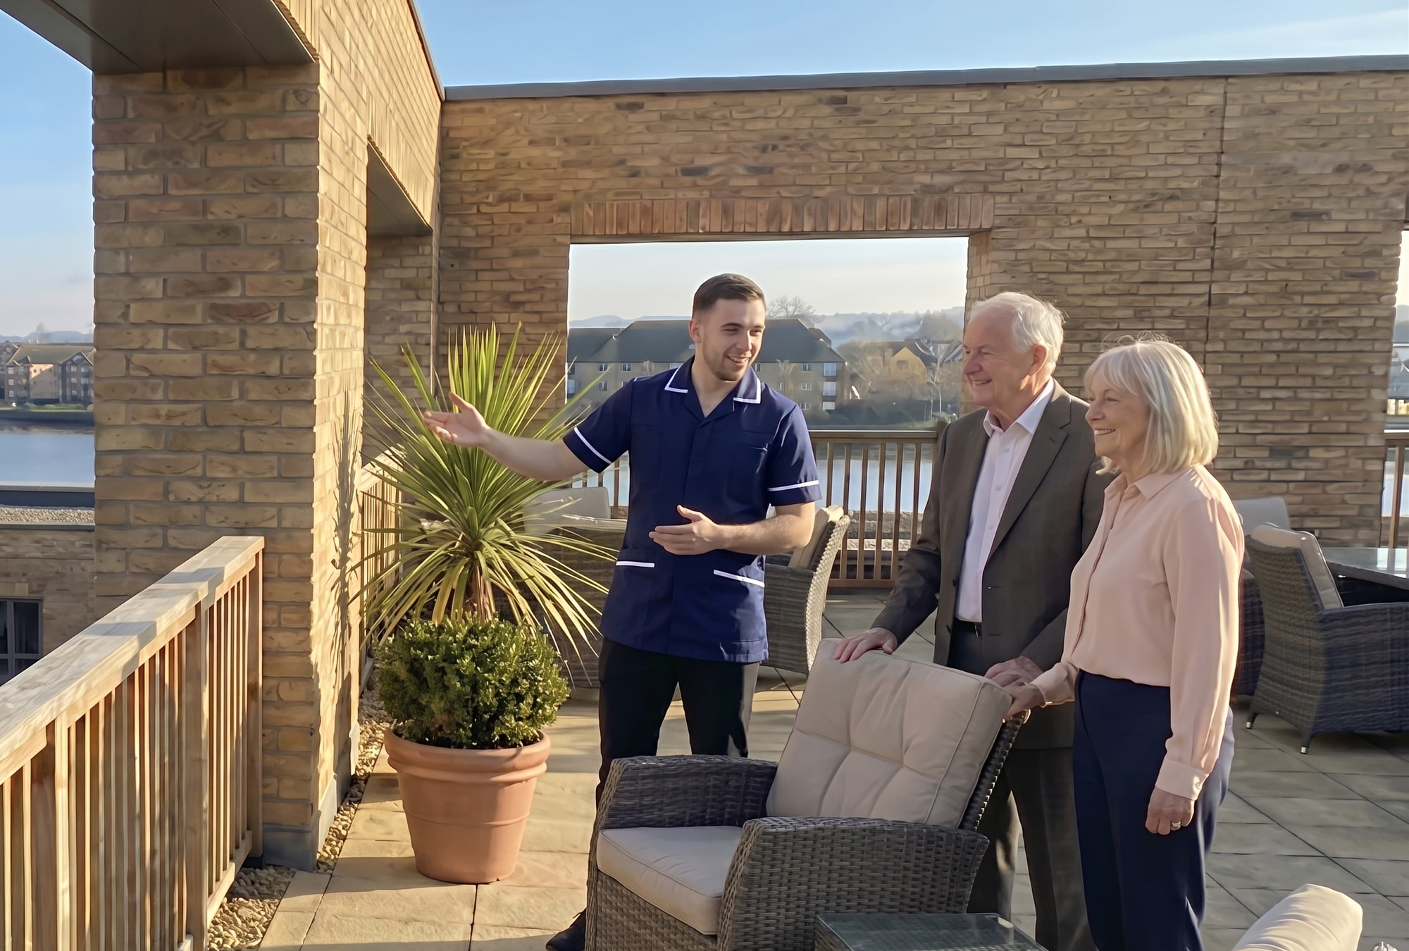
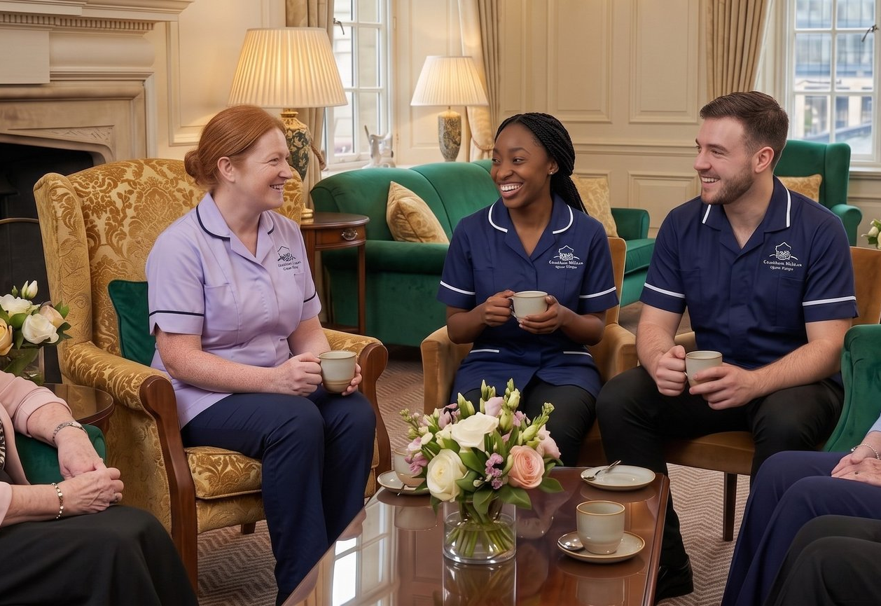

[HERO: Family / visiting image — swap in PowerPoint]
Living Well, Every Day
TRANSPARENT, INCLUSIVE PRICING
GARDEN
SPACES
SOCIAL
SPACES
What’s included in your weekly fee:
Our rooftop garden and external terraces offer peaceful retreats with views across the water. They provide fresh air, gentle movement, and quiet reflection, with raised beds and sensory planting for all abilities.
Throughout the home, communal areas are designed for both connection and privacy. Whether you want company or quiet time, there’s a space that suits your mood.
Chiropody
Wi-Fi and all entertainment
Hair salon appointments
All activities and outings
Full access to every communal space and amenity
Family dining so loved ones can share meals with you at no charge
Direct access from communal areas
Level pathways, benches, and sensory planting
Seasonal planting for year-round interest
Spaces for gardening, relaxing with a drink, or simply watching the sky
Comfortable lounges and library corners
Café/bistro open all day for drinks and conversation
Private dining rooms for family gatherings
Quiet reading and reflection spaces
Rooftop sky lounge with waterfront views
There are no surprise bills. No hidden extras. Everything you need is covered, so you can focus on living well...
The gardens are yours to enjoy at your own pace.
Every space is designed for connection, calm, and everyday joy.
OPENING SUMMER 2026
01634 623548 · info@chathamwaterscarehome.co.uk
REGISTER INTEREST
CHATHAMWATERSCAREHOME.CO.UK

Slide 16
Insert 6

Slide 17

Your Home
Designed for Comfort. Built for Connection.
At Chatham Waters Care Home, the environment is part of the care. Every space is designed for sensory comfort, emotional wellbeing, and everyday joy.
Architecture, materials, and lighting work together to reduce anxiety, support orientation, and invite connection. This is a place to feel at home.
YOUR BEDROOM
DESIGNED TO REDUCE ANXIETY
Every resident has a private bedroom with a full ensuite shower room. Rooms are light-filled, very spacious, and finished for comfort and clarity.
Key features:
Large windows, large beds, and easy navigation
Level-access showering, grab rails, and non-slip surfaces
Simple control of temperature and lighting
Space to personalise with photos, artwork, and familiar items
We use colour, texture, lighting, and layout to reduce anxiety and support orientation. Every choice is informed by dementia research, best practice, accessibility standards, and lived experience.
Key design features:
Contrasting colours to distinguish doors, walls, and furniture
Matte finishes to reduce glare and visual confusion
Tactile handrails for sensory feedback and support
Consistent layouts for easier wayfinding and memory
Maximised natural light throughout the building
Warm, adjustable artificial lighting
Acoustic materials that soften background noise
Familiar cues, such as domestic-style kitchens
The environment works quietly in the background, supporting wellbeing without drawing attention to itself.
This is your room and your home, designed to feel that way from the moment you arrive.
OPENING SUMMER 2026
01634 623548 · info@chathamwaterscarehome.co.uk
REGISTER INTEREST
CHATHAMWATERSCAREHOME.CO.UK

Slide 18
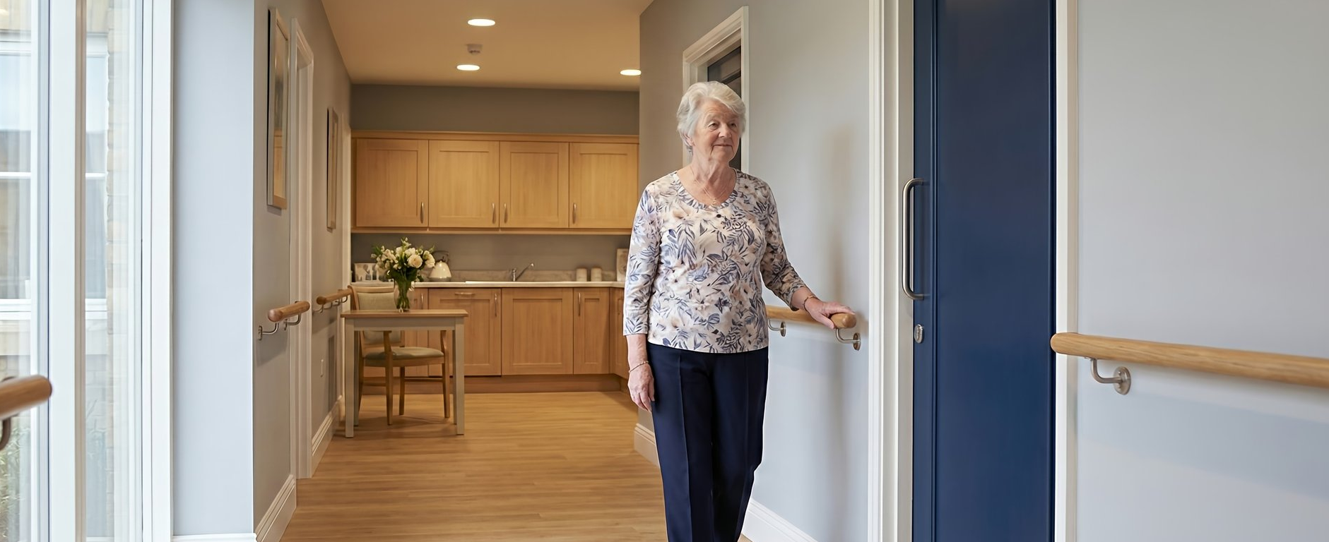
[HERO: Accessibility / garden image — swap in PowerPoint]
[HERO IMAGE 9 — Lifestyle / dining — swap in PowerPoint]
[HERO: Family / visiting image — swap in PowerPoint]
Built for All
BUILT FOR ALL ABILITIES
GARDEN SPACES
Our building is fully step-free, with wide corridors, lift access, and wheelchair-friendly communal spaces. Doors accommodate mobility aids, handrails support indoor and outdoor routes, and seating is placed throughout for rest.
Clear, high-contrast signage with pictorial cues
Textured flooring to signal transitions
Consistent lighting to reduce disorientation
Our rooftop garden and external terraces offer peaceful retreats with views across the water.
Direct access from communal areas
Controlled access to the local park
Level pathways, benches, and sensory planting
Wide, level pathways with handrails
Seasonal planting for year-round interest
SOCIAL & ENTERTAINMENT
THE SANCTUARY & GYM
Our entertainment suite offers shared activity opportunities, memory stimulation, and community events.
Comfortable, accessible cinema with resident-led film choices
Library spaces designed for calm, focus, and gentle social connection
Café/bistro at the heart of daily life
Our gym and sanctuary provide opportunities for exercise, calm reflection, therapy, and peace in fully accessible spaces.
Health and wellbeing sessions with one-to-one support
Flexible, personalised use at no extra charge
Spaces that promote confidence, comfort, and personal wellbeing
Come and See What Makes Us Different
Register Interest or book a visit · Call 01634 623548
CHATHAM WATERS CARE HOME
01634 623548 · info@chathamwaterscarehome.co.uk
REGISTER INTEREST
CHATHAMWATERSCAREHOME.CO.UK

